Slide 1
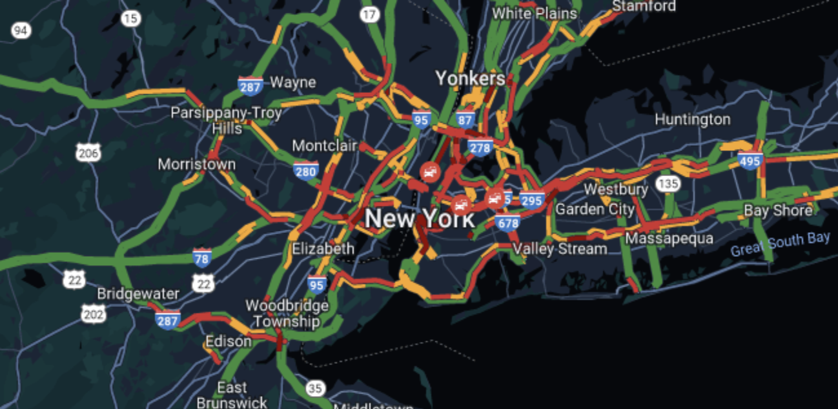
Analysis of Traffic Accidents
In New York City
Modelling data for all collisions to understand
any patterns or consistencies
Authors: Joseph Olaniyan
Prachi Shah
Levan Getia
Angelo Hovarth

Slide 2
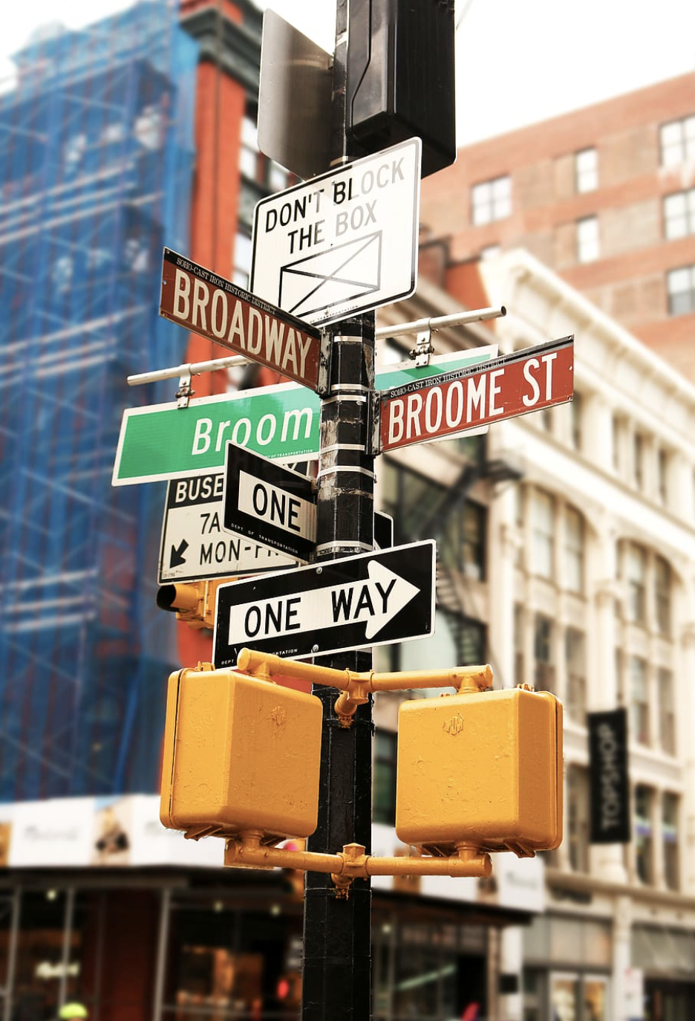
Introduction
General NYC characteristics
New York city is home to 8.5 million people
In 2022, there were around 100,508 total traffic accidents in NYC
This breaks down to about roughly 625 accidents per day
Reasons for choosing NYC as a model city
NYC is a very traffic accident prone city
It has vast data of accidents that can be analyzed
38% of all traffic accidents in NYC end with fatality or injury

Slide 3
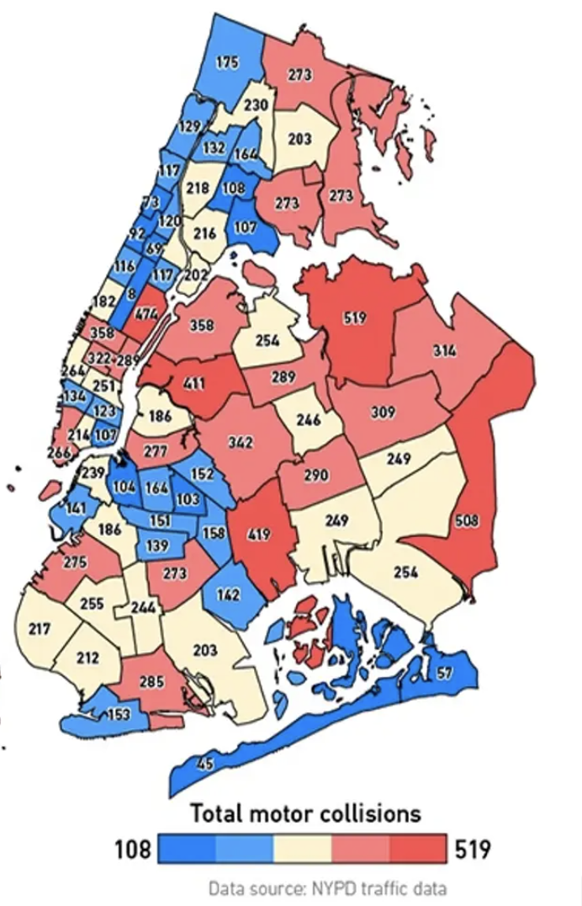
Project Outline
The Data
Firstly, data is obtained from CSV file, which contains accident entries
Afterwards it is cleaned using jupyter notebook and loaded to mongoDB
Afterwards API is set up to access data through server
Modelling and Analysis of data
Analysis is mainly performed through javascript usage
We developed webpage which will serve as a main project host
Our project performs analysis of whole data and models patters
Mainly, our goal was to capture vehicles that are most susceptible
to accidents and what regions of NYC, or also what time of day is the
riskiest, in terms of getting in an accident

Slide 4
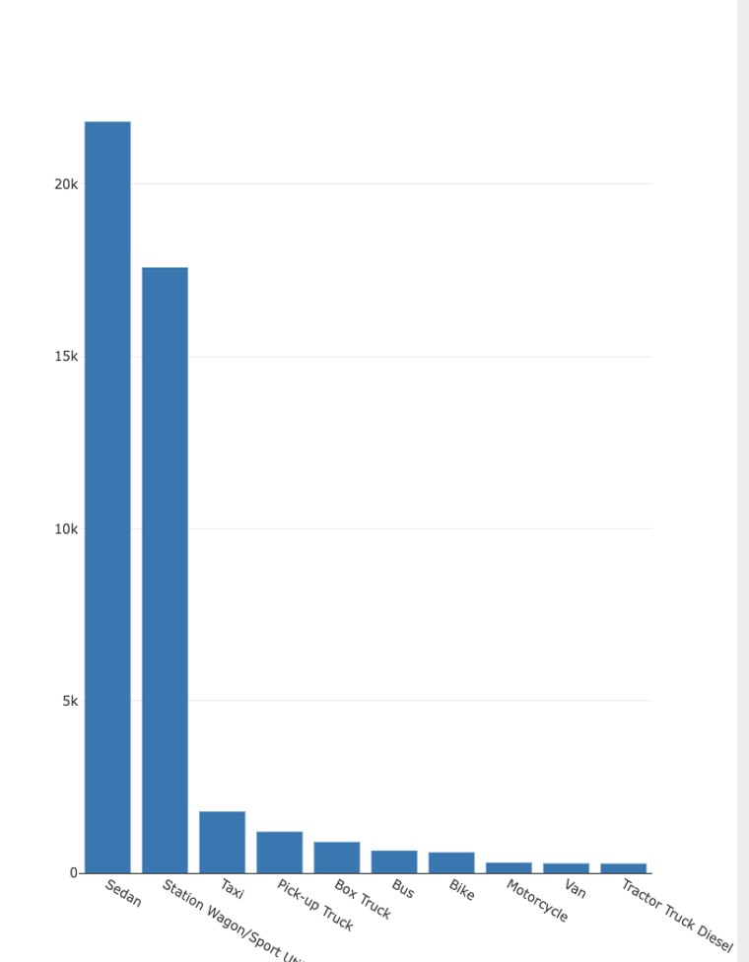
Project attributes
Visualization
Project offers map with several layers, which gives out clustered data
of all the accidents according to their location, as well as top 3 and bottom
3 cities where accidents are most or least likely to happen.
We also developed a pie chart, which tries to capture the part of day when most
accidents happen statistically.
Lastly, this project offers bar chart, modelling the top 10 vehicle types that
are prone to getting into the accidents
Hard Data
Project provides cleaend csv file with no null entries
There are 3 different APP routes that can be accessed after running app.py
Data is collection of all motor collisions reported to NYPD from
January 2020 to August 2020

Slide 5
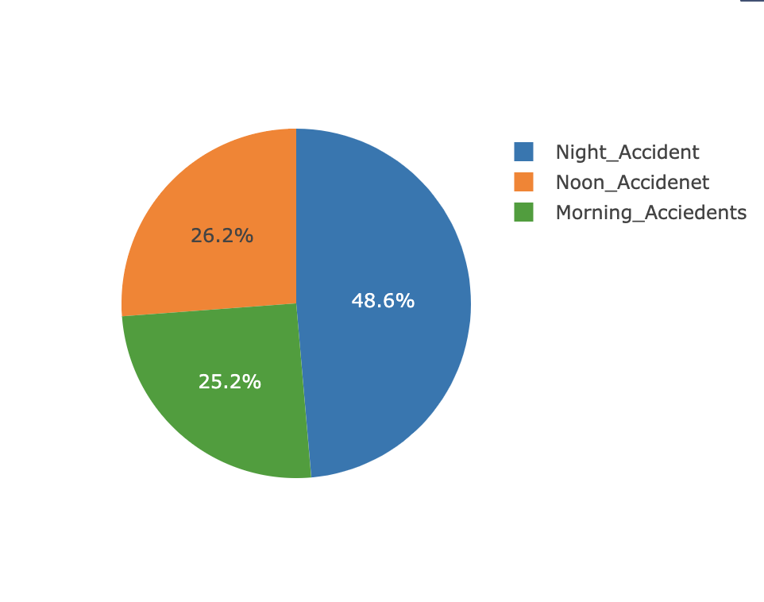
Key Findings
Accident Statistics
Nearly half of the accidetns took place at night time, specifically from 12 am
to 5pm
Morning and Afternoon crashes both shared quarter of total data with
afternoon crashes higher with just 1 %
Sedan is number one in terms of most accidents, followed by SUV, both have
accounted for more than 15 thousand records each, compared to just 301 or
277 for motorcycle and van respectively, in the same timeframe.
NYC Regional acccident data
Queens and Brooklyn have recorded most of tha accidents for the given period.
Staten Island was safest region with just under 1400 accidents
Manhattan recorded second to last in terms of accidents with Riverside Drive,
happened to be one of the least accidental streets inside Manhattan.

Slide 6
References
Data
Initial data is pipelined through csv from Maven Analytics : https://mavenanalytics.io/data-playground?page=6&pageSize=5
Add-ons Used: Leaflet plugins : https://leafletjs.com/plugins.html
OpenStreetMap: https://www.openstreetmap.org/#map=3/71.34/-96.82
Software and Languages used: Jupyter Notebook, Python, JavaScript, Google Chrome.
GitHub Link: https://github.com/Prachi-Shah1002/Project_3

Slide 7
Thank you ! Lets expxlore the webpage
☺

